Slide 1
Welcome to Technical Bootcamp: Day 2

Slide 2

A look into the Day 2 agenda:
Day 2
Design Presentations: Spark for Data Science
Break
Please refer to the descriptions below for reference
Design Presentation: Security
Design Presentation: Monitor & Manage
Types of activities:
Attendees will participate in four different types of activities:
Break
PoC Challenge 3
Keynote
Labs
Long Break
Presentations
Challenges
Continue PoC Challenge 3
Breakout Activity
Location of activities:
Each activity will take place in the following location:
Break
PoC Challenge 4
All-up Session: Teams bridge in calendar invite
Break
Breakout Activity: “Meet Now” function in Teams Table Group channel
Continue PoC Challenge 4
Independent working time: No meeting, working in Spektra labs
Closing

Slide 3
Spark for Data Science

Slide 4

Agenda
1 Spark in Synapse
How Spark is utilized within Synapse.
2 Notebooks
Understand the notebook paradigm and how to use them in Synapse.
3 Machine Learning with Synapse and Azure ML
How to train and deploy models with Synapse and Azure Machine Learning.

Slide 5
Spark in Azure Synapse Analytics

Slide 6

Azure Synapse Apache Spark - Summary
Apache Spark 2.4 derivation
Linux Foundation Delta Lake 0.6.1 support
.Net Core 3.1 support
Python 3.6 + Anaconda support
Tightly coupled to other Azure Synapse services
Integrated security and sign on
Integrated Metadata
Integrated and simplified provisioning
Integrated UX including nteract based notebooks
Fast load of SQL Analytics pools
Core scenarios
Data Prep/Data Engineering/ETL
Machine Learning via Spark ML and Azure ML integration
Extensible through library management
Efficient resource utilization
Fast Start
Auto scale (up and down)
Auto pause
Min cluster size of 3 nodes
Multi Language Support
.Net (C#), PySpark, Scala, Spark SQL, Java

Slide 7
Synapse Job Service
AAD
Synapse Studio
Synapse Service
Gateway
Auth Service
Job Service Frontend
…
Resource Provider
Spark API Controller
DB
Job Service Backend
Azure
Instance Creation Service
Spark Plugin
…
DB
DB
Spark Instance
VM
VM
VM
VM
VM
VM
Notes:
User attaches Notebook to Spark pool and enters one or more Spark statements (code blocks).
The Notebook client gets user token from AAD and sends a Spark session create request to Synapse Gateway.
Synapse Gateway authenticates the request and validates authorizations on the Workspace and Spark pool and forwards it to the Spark (Livy) controller hosted in Synapse Job Service frontend.
The Job Service frontend forwards the request to Job Service backend that creates two jobs – one for creating the cluster and the other for creating the Spark session.
The Job service backend contacts Synapse Resource Provider to obtain Workspace and Spark pool details and delegates the cluster creation request to Synapse Instance Service.
Once the instance is created, the Job Service backend forwards the Spark session creation request to the Livy endpoint in the cluster.
Once the Spark session is created the Notebook client sends Spark statements to the Job Service frontend.
Job Service frontend obtains the actual Livy endpoint for the cluster created for the particular user from the backend and sends the statement directly to Livy for execution.

Slide 8
Spark Instance Creation
Azure Resource Provider
3
Provision Resources
Spark Instance
2
Create VMs with
Specialized VHD
Subnet
VM – 001
VM – 002
VM – 003
VM – 004
VM – 005
Spark Executors
Spark Executors
Spark Executors
Spark Executors
Hive Metastore
YARN NM - 01
Livy - 01
YARN NM - 02
Zookeeper - 01
Zookeeper - 02
Zookeeper - 03
YARN RM - 01
YARN RM - 02
YARN NM - 03
YARN NM - 04
Node Agent
Node Agent
Node Agent
Node Agent
Node Agent
1
Create Cluster
Synapse Cluster
Service
(Control Plane)
4
Heartbeats
Heartbeat sequence
Notes:
Synapse Job Service sends request to Cluster Service for creating clusters per the description in the associated Spark pool.
Cluster Service sends request to Azure using Azure SDK to create VMs (required plus additional) with specialized VHD.
The specialized VHD contains bits for all the services that are required by the Cluster type (for e.g. Spark) with prefetch instrumentation.
Once VM boots up, the Node Agent sends heartbeat to Cluster Service for getting node configuration.
The nodes are initialized and assigned roles based on their first heartbeat.
Extra nodes get deleted on first heartbeat.
After Cluster Service considers the cluster ready, it returns the Livy end-point to the Job Service.

Slide 9
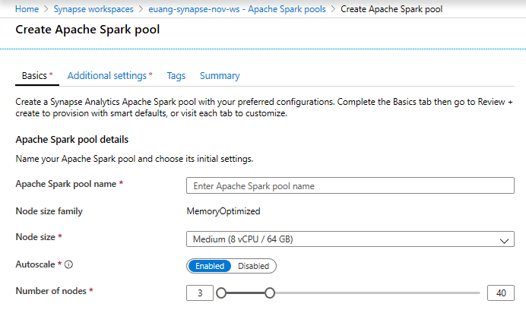
Creating a Spark pool (1 of 2)
Provision Spark Pool through Azure Portal with default settings or per requirements
Basic Settings – Minimum details required from user
Only required field from user
Default Settings

Slide 10
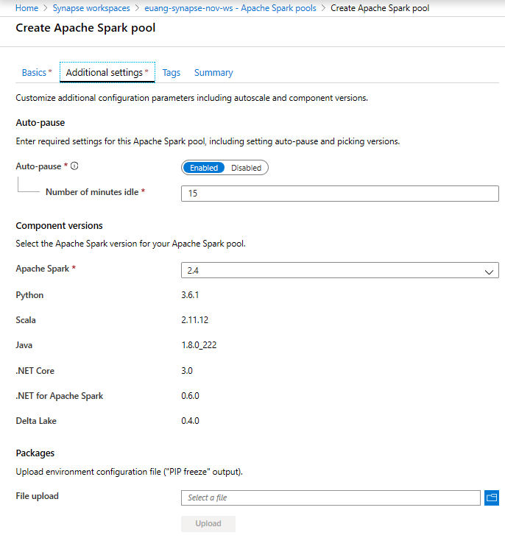
Creating a Spark pool (2 of 2) - optional
Additional Settings offer optional settings to customize Spark pool
Customize component versions, auto-pause
Import libraries by providing text file containing library name and version

Slide 11
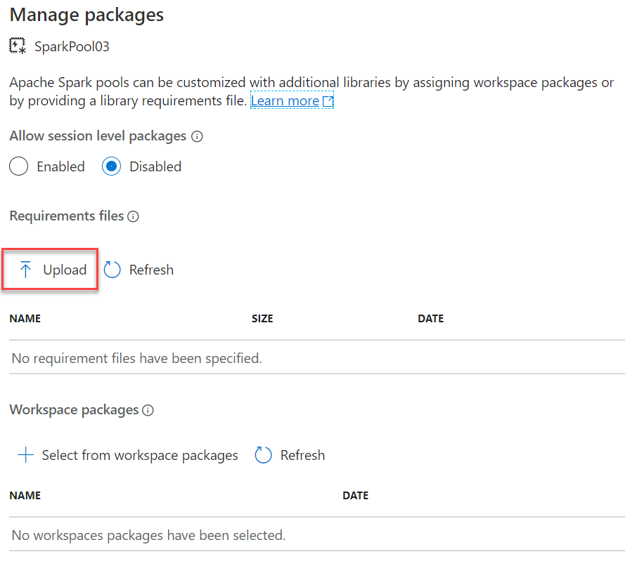
Library Management - Python
Overview
Customers can add new python libraries at Spark pool level
Benefits
Input requirements.txt in simple pip freeze format
Add new libraries to your cluster
Update versions of existing libraries on your cluster
Libraries will get installed for your Spark pool during cluster creation
Ability to specify different requirements file for different pools within the same workspace
Constraints
The library version must exist on PyPI repository
Version downgrade of an existing library not allowed
Notes:
Manage libraries for Apache Spark - Azure Synapse Analytics | Microsoft Docs
Current default installed libraries and versions:
Apache Spark version support - Azure Synapse Analytics | Microsoft Docs

Slide 12
Python Library Requirements Format
Overview
The requirements text file has specific format requirements. These files are traditionally created in Python environments by running the pip freeze command, but are also easy to create by hand.
File must be named requirements.txt.
Each line contains a requirement specifier.
This must contain at least the package name. You can also specify optional extras, an operator and version numbers according to the PIP requirements file standard.
The basic operators used by version specifiers are:
An exact version (using ==).
A minimum version (using > or >=).
A maximum version (using < or <=).
The extras listed in square brackets ([]) allow you to install additional components or variants of the library.
libraryname ==1.3.0

Slide 13
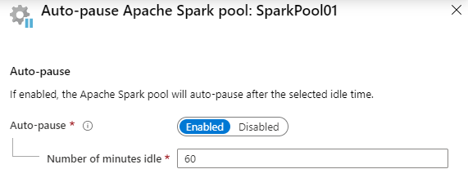
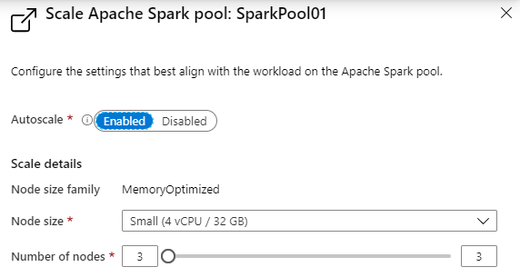
Spark Pools - Configuring
Auto-pause
Enables the pool to automatically stop running when no Spark applications (e.g., Notebooks) are running.
Autoscale
Enables the pool to automatically adjust the number of running nodes (VM’s) supporting the Spark pool.
Note: Just because a pool is running, does not mean all the nodes allowed to run, according to the scale configuration, are actually running. They will be allocated on demand as new Notebooks are executed, up to the limit configured in autoscale.

Slide 14
Notebooks in Azure Synapse Analytics

Slide 15
The Notebook Paradigm – one UI for data science
Collect Data
Retrieve Files
Evaluate
Model
Test Performance
Query SQL Databases
Compare Models
Call Web Services
Validate Model
“Scrape” Web Pages
Visualize Performance
Execute arbitrary:
- Python code
- R code
- SQL queries
- Shell commands
Prepare Data
Explore Data
Deploy
Model
Export Model File
Validate Data
Prepare Job
Clean Data
Deploy Container
Featurize Data
Re-package Model
Notebook
(Synapse Spark)
Train Model
Prepare Training Set
Experiment
Test Model
Visualize Performance

Slide 16

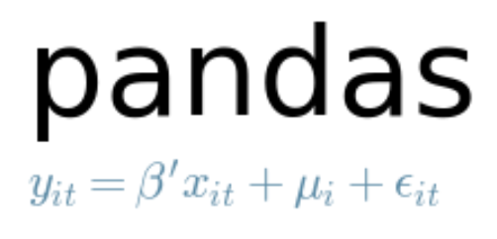

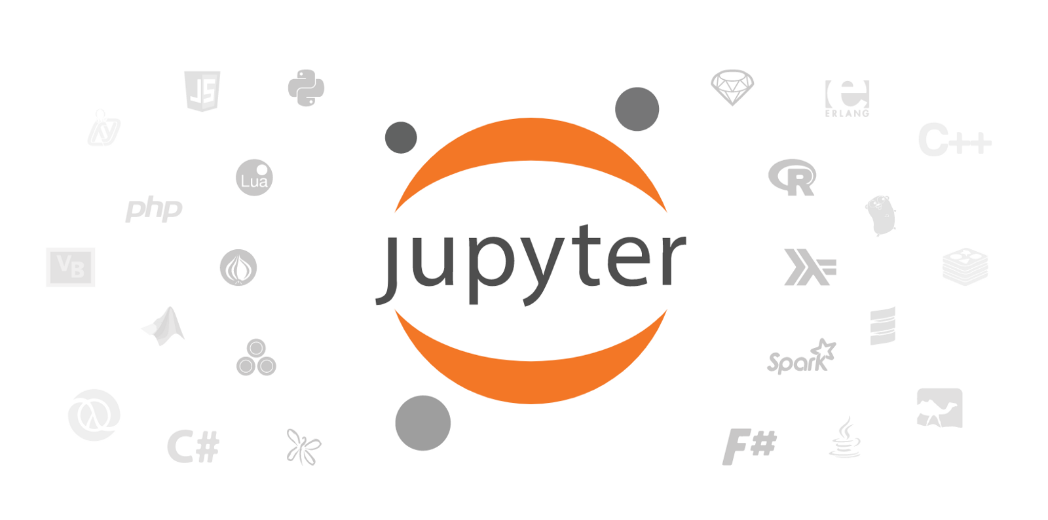









Examples of tools for data science used in Notebooks
Core frameworks and tools
Machine Learning & Deep Learning
Keras
PyTorch
Visualization

Slide 17
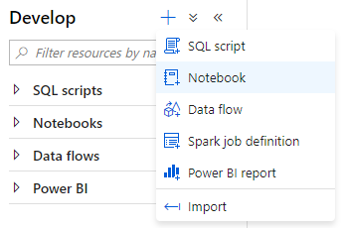
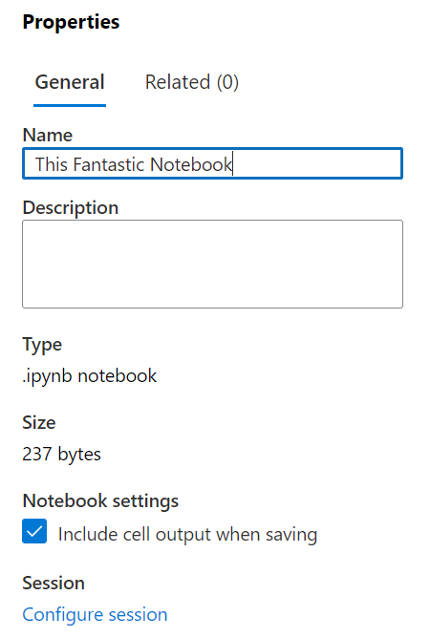
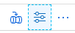
Creating a Notebook
Notebook creating
Create a new notebook within the Develop hub of Synapse Studio.
Notebook naming
The name of the Jupyter notebook can be set in the Properties dialog. You can now re-name published notebooks!

Slide 18
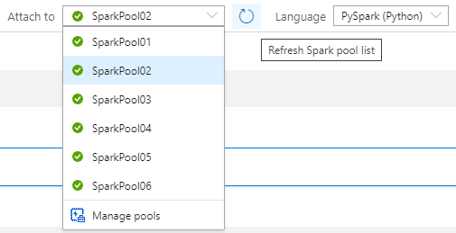
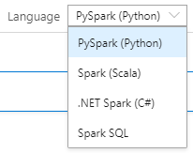
Notebook setup
Selecting the Spark pool to attach to
In the notebook toolbar, select the Spark pool to attach to before running any cells in the notebook.
Notebook default language
The default language used for all cells in the notebook is selected in the Language drop down.
You can override this for any particular cell to use a different language by using the appropriate cell magic (covered later).

Slide 19
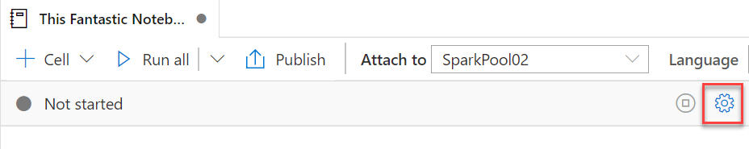
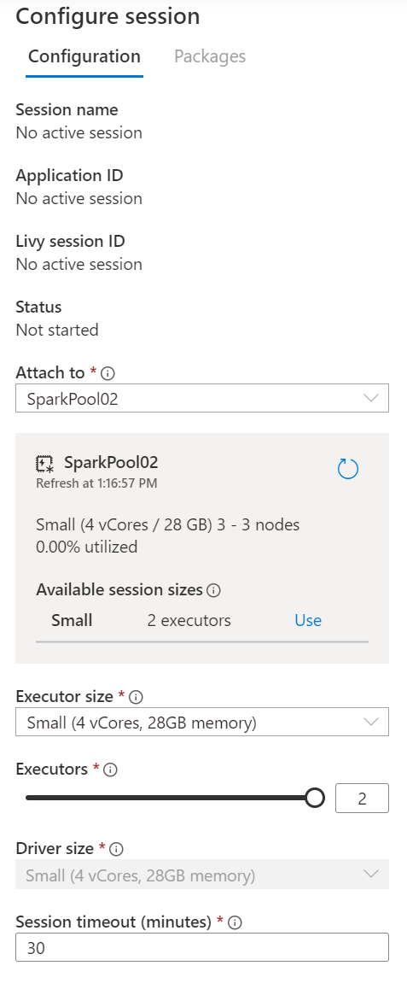
Notebook setup – Session configuration
A Spark session is created upon first run of any cell in a notebook. The configuration for a Spark session can only be set before it is created.
The Spark session allocates one Spark application.
This Spark application consumes a fixed set of resources, as defined in the session configuration. These resources are reserved from the total resources available in the Spark pool upon session start.
Each session reserves resources for at least one driver process and two executor processes. You can configure the size of executors, as well as the number of executors. The size of the driver is always the same as the executors.
A session ends when the notebook is closed or when the session timeout is reached without any activity in the notebook. You can configure the session timeout.

Slide 20
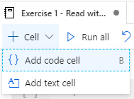
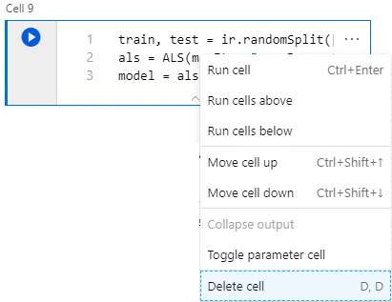
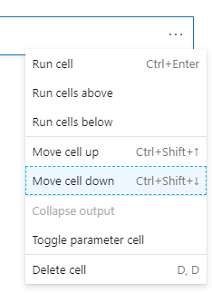
Notebook capabilities – Cell management
Add code or text cells
Remove code or text cells
Adjust cell order

Slide 21
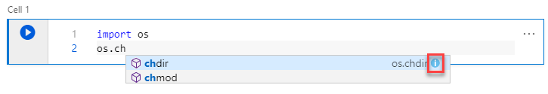
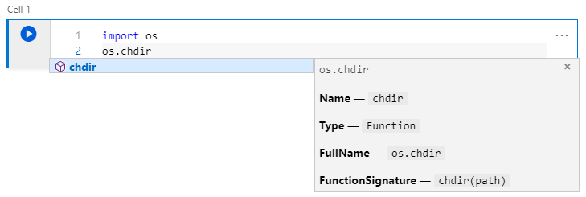
Notebook capabilities – Editing code
Statement completion
Use Ctrl + Space to display
Inline documentation
Select the information tooltip to display

Slide 22
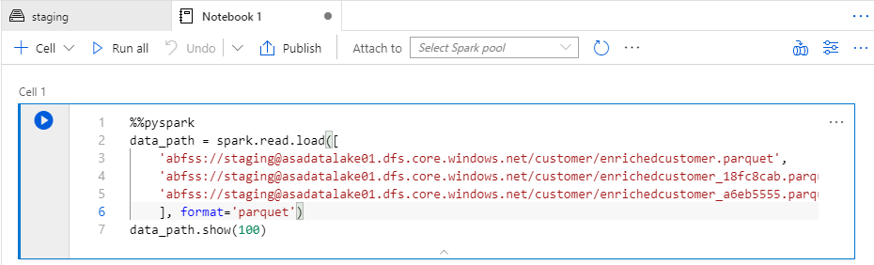
Notebook capabilities – Editing code
Cell magics
Use cell magics to change the language used when interpreting the cell.
These must be the first line in the cell.
Magic | Description
%%pyspark | Execute Python code against Spark Context.
%%spark | Execute Scala code against Spark Context.
%%sql | Execute Spark SQL query against Spark Context.
%%csharp | Execute Spark.NET C# code against Spark Context.

Slide 23
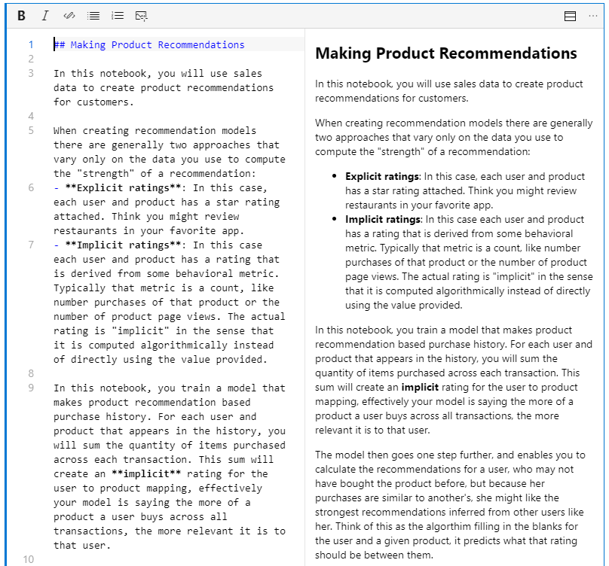
Notebook capabilities – Editing text cells
Support for GitHub flavored markdown
Notebooks support GitHub flavored markdown, enabling limited text formatting, links, lists, code blocks and images.

Slide 24
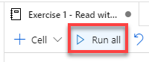
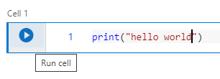
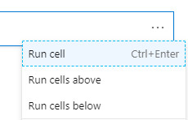
Notebook capabilities – Running cells
Run all cells from toolbar
Run current cell from toolbar from cell itself

Slide 25
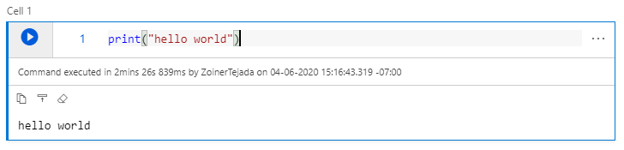
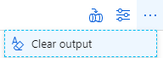
Notebook capabilities – Cell output
Cell output
Clear all cells output from toolbar

Slide 26
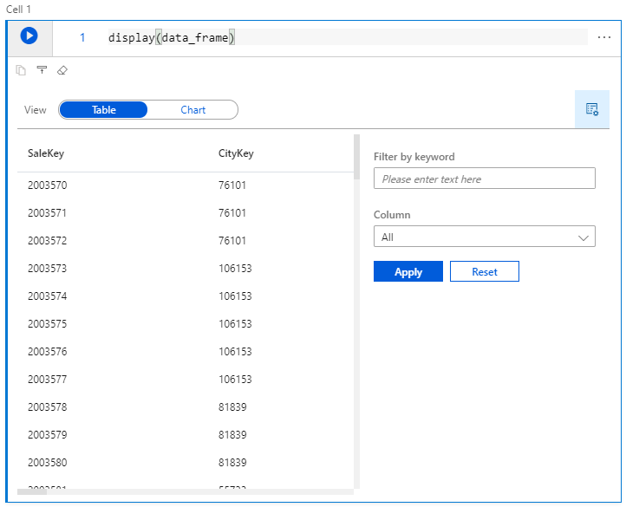
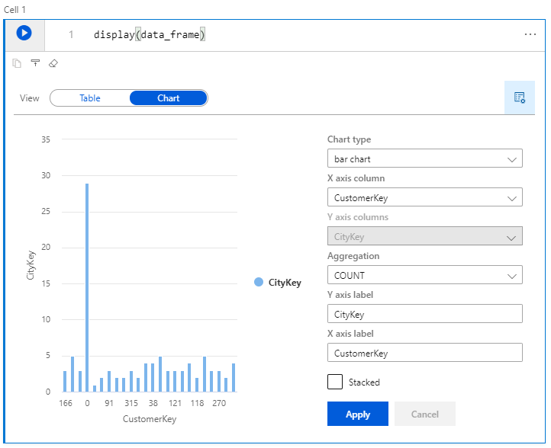
Spark Pools – Notebook capabilities
View DataFrame content as table or chart
Use the display function and pass in your dataframe.

Slide 27
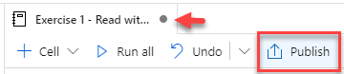
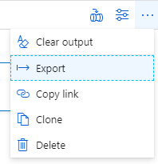

Spark Pools – Notebook capabilities
Saving (publishing)
Exporting (download the .ipynb)

Slide 28
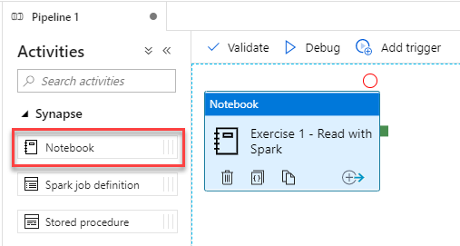
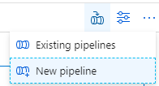
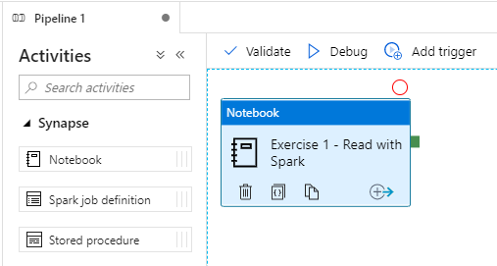
Notebook capabilities – Use in pipelines
Notebooks are pipeline activities
Execute a notebook as a step in a new pipeline

Slide 29
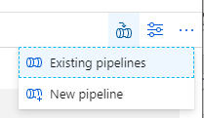
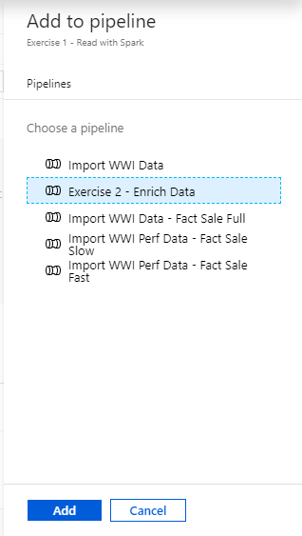
Notebook capabilities – Use in pipelines (2)
Execute a notebook as a step in an existing pipeline

Slide 30
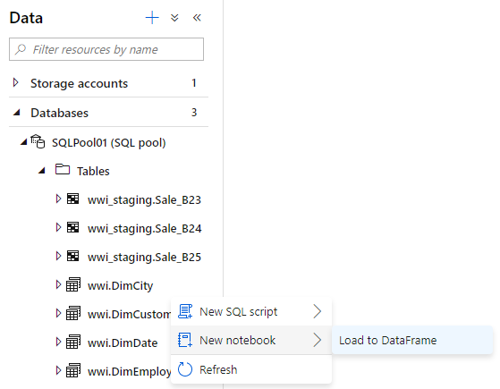
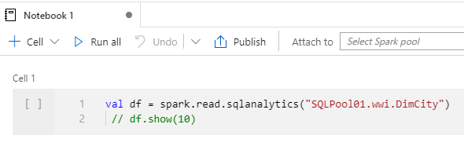
Notebook capabilities – Querying SQL Pools
Loading a SQL Pool table to a DataFrame

Slide 31
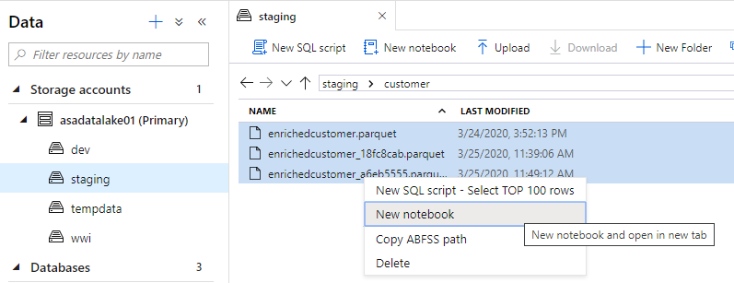
Notebook capabilities – Querying Parquet Files
Loading Parquet files to a DataFrame

Slide 32
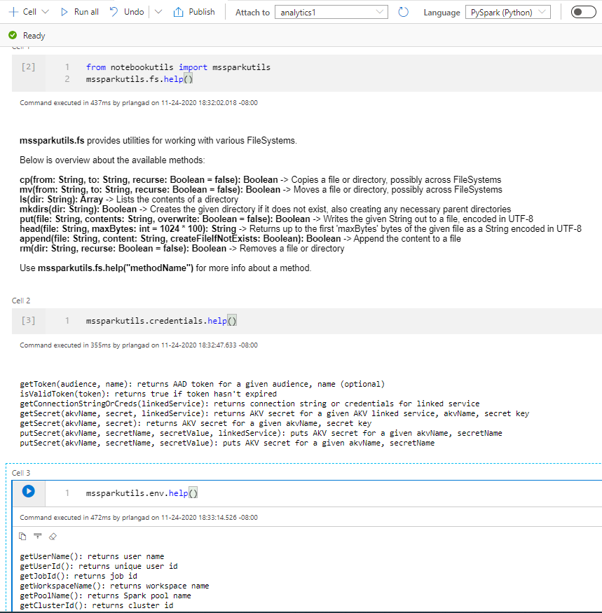
Microsoft Spark Utilities
Overview
It provides utilities for working with file systems, including ADLS Gen2 and Azure Blob Storage.
Benefits
It supports multiple methods for file systems such as List, Copy, Move, Write, Append, Delete file or directory, View file properties, Create new directory, Preview file content.
It supports environment utilities to get username, user id, job id, workspace name, pool name, cluster id.
It supports to get the access tokens of linked services and manage secrets in Azure Key Vault.
Notes:
Microsoft Spark Utilities

Slide 33
Pop Quiz #4
What types of library sources are supported in Azure Synapse Spark?
Maven
Spark
PyPi

Slide 34
Pop Quiz #4
What types of library sources are supported in Azure Synapse Spark?
Maven
Spark
PyPi

Slide 35
Machine Learning in Azure Synapse Analytics

Slide 36
Spark ML Algorithms
Classification and Regression | Linear Models (SVMs, logistic regression, linear regression) Naïve Bayes Decision Trees Ensembles of trees (Random Forest, Gradient-Boosted Trees) Isotonic regression
Clustering | k-means and streaming k-means Gaussian mixture Power iteration clustering (PIC) Latent Dirichlet allocation (LDA)
Collaborative Filtering | Alternating least squares (ALS)
Dimensionality Reduction | SVD PCA
Frequent Pattern Mining | FP-growth Association rules
Basic Statistics | Summary statistics Correlations Stratified sampling Hypothesis testing Random data generation
Spark ML Algorithms

Slide 37








Synapse Analytics and the Machine Learning Process
Prepare data
Train model
Use model
Azure Machine Learning
Azure Synapse SQL
Azure Synapse Analytics
Notebook
SQL Script
Spark Notebook
Train model
T-SQL PREDICT
Prepare data
SQL Script
Azure Databricks
(Spark-based Machine Learning)
Azure Kubernetes Service
Prepare data
Notebook
Web service
Train model
Real-time scoring
Notes:
Synapse SHOULD be preferred for performing Data Engineering.
ML training should ALWAYS be done within AML. And, if you happen to have Spark based ML, then that would be a case to consider Azure Databricks.
Then to augment that you can operationalize by deploying to AKS or in some cases to the T-SQL Predict.

Slide 38

Making predictions with T-SQL
Create the model
Register the model
Use the model
Azure Machine Learning
Azure Synapse SQL
Azure Synapse SQL
Notebook
SQL Script
SQL Script
Train Model
Read model
Load from Table
Convert to ONNX
Load into Table
Use Predict
Export to Storage
Insert Predictions
Storage
Models
Notes:
The diagram illustrates the approach the Azure Synapse Analytics enables for machine learning.
Train the machine learning models using notebooks run within Azure Machine Learning. Use the machine learning framework of choice to do so. Model training should always be performed in AML.
Within this notebook, convert the model into the ONNX format and then upload the model to Azure Storage.
From there, run a T-SQL script in Azure Synapse SQL to load the model into a table in the database.
After this, use the model within T-SQL scripts running Azure Synapse SQL by loading the model from the table, and using it with the Predict statement to score data sourced from a table in the database. The scored results could then be used directly or be inserted into a target table for later querying of the predictions.

Slide 39
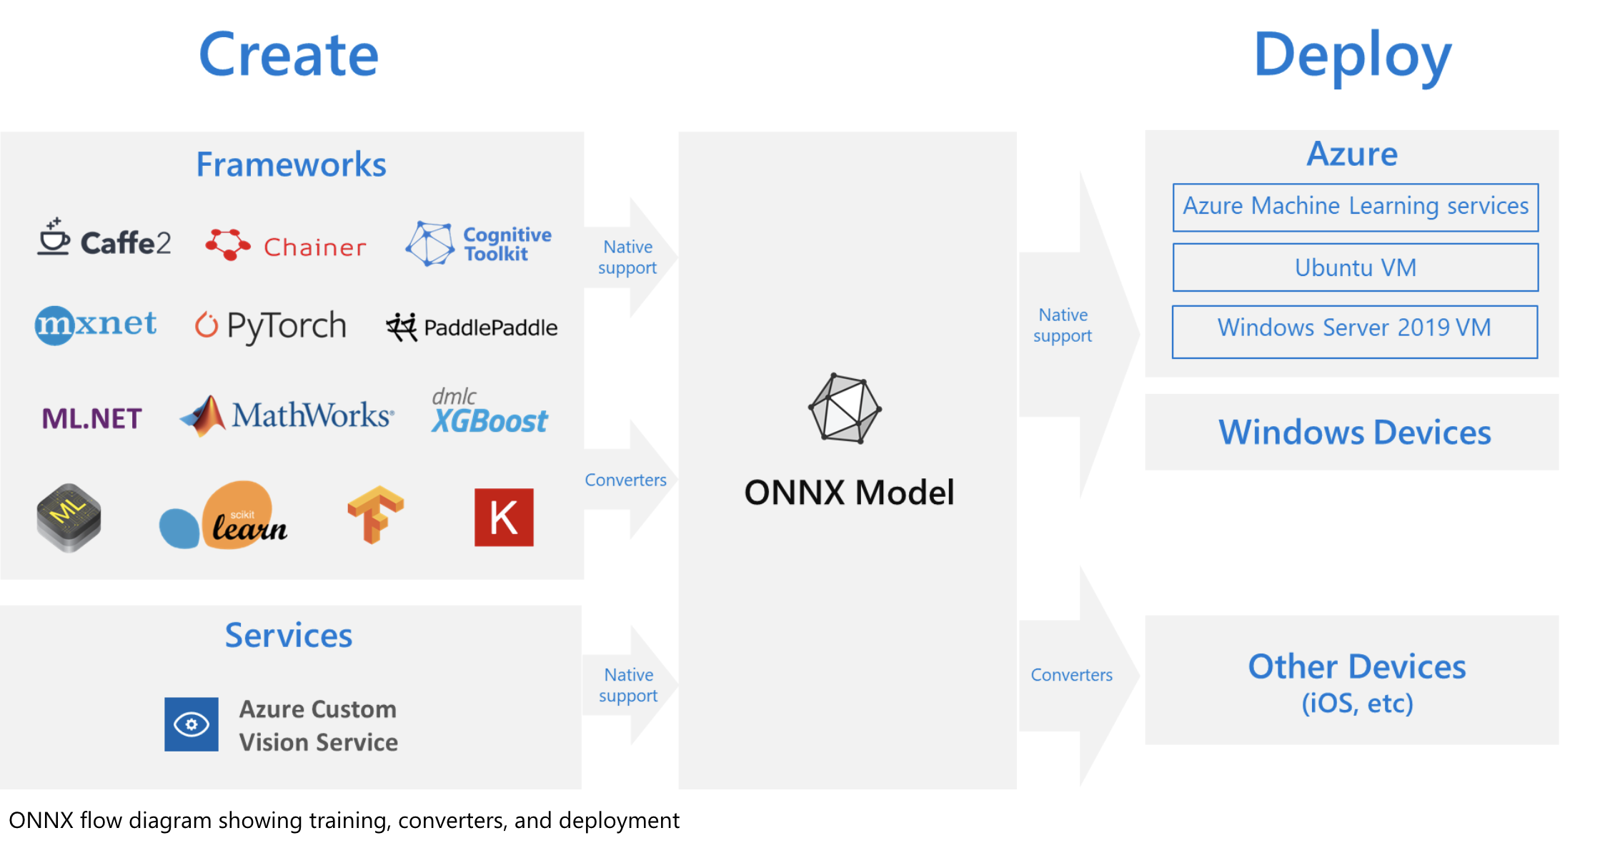
What is ONNX?
Notes:
The challenges of optimizing the performance of machine learning models in production is extremely hard considering the range of hardware capabilities on different platforms such as cloud vs edge, CPU vs GPU etc. and couple that with the variety of frameworks that available for building and training the machine learning models.
To support the idea of providing users the flexibility to train their machine learning models on framework of their choice, and run that model anywhere with optimal performance, is at the core of Open Neural Network Exchange (ONNX) format for representing machine learning models. ONNX is an open format, that is supported by a community of partners, including Microsoft, who create compatible frameworks and tools.
You can create ONNX models from many frameworks, including PyTorch, Chainer, Microsoft Cognitive Toolkit (CNTK), MXNet, ML.Net, TensorFlow, Keras, SciKit-Learn, and more. ONNX Runtime is optimized for both cloud and edge and works on Linux, Windows, and Mac, and it also integrates with accelerators on different hardware such as TensorRT on NVidia GPUs. ONNX models can be deployed to the cloud using Azure Machine Learning and ONNX Runtime. They can also be deployed to Windows 10 devices using Windows ML. They can even be deployed to other platforms using converters that are available from the ONNX community.
The interoperability you get with ONNX makes it possible to get great ideas into production faster. With ONNX, data scientists can choose their preferred framework for the job. Similarly, developers can spend less time getting models ready for production, and deploy across the cloud and edge.
Data scientists: use the framework of their choice to create and train models
Developers: deploy models cross-platform with minimal integration work

Slide 40
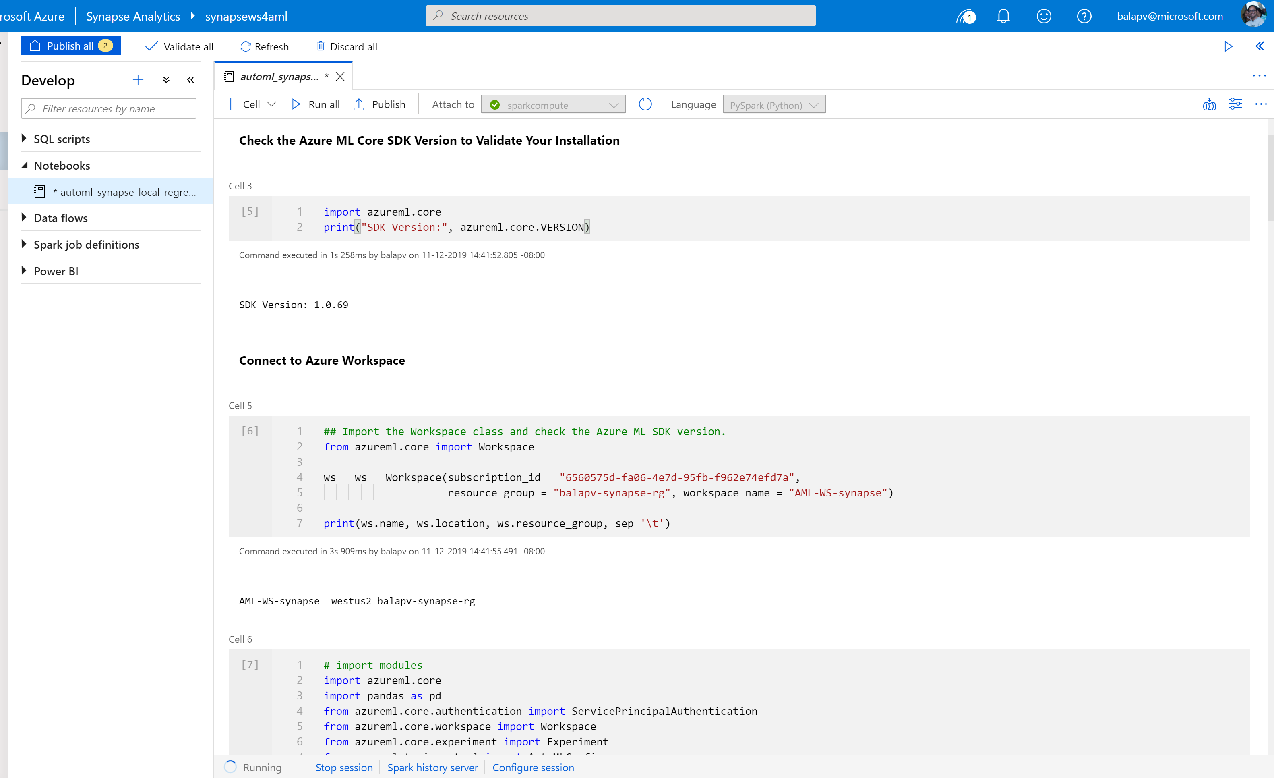
Synapse Notebook: Connect to AML workspace
Simple code to connect workspace

Slide 41
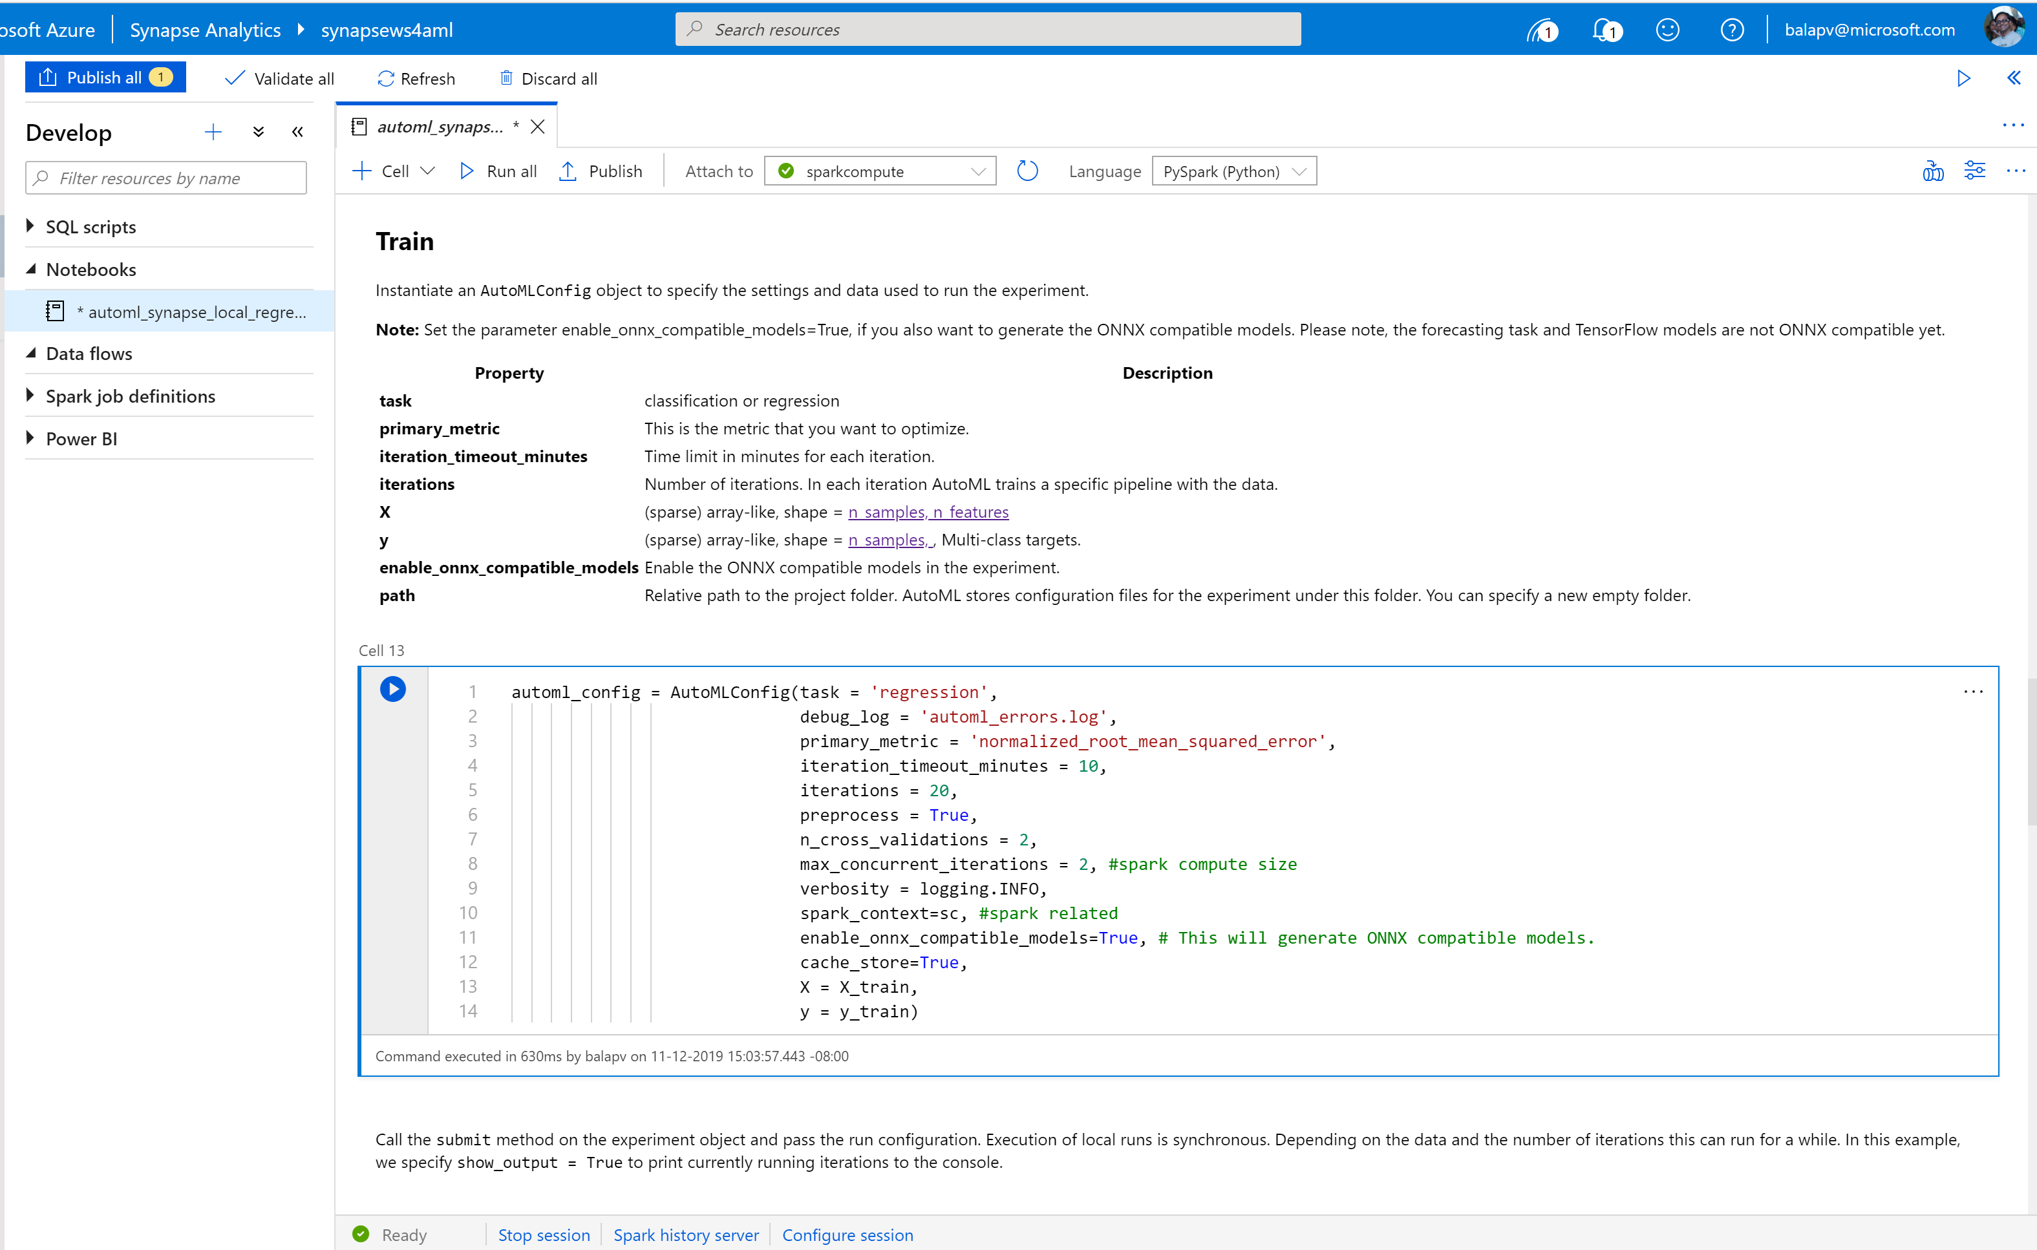
Synapse Notebook: Configure AML job to run on Synapse
Configuration parameters

Slide 42
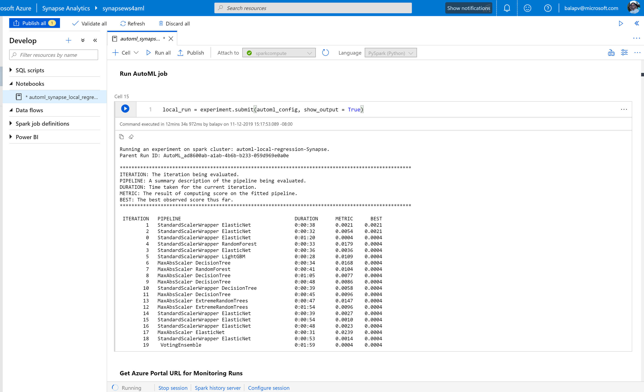
Synapse Notebook: Run AML job
ML job execution result

Slide 43








Modern Data Warehouse
INGEST
PREPARE
TRANSFORM & ENRICH
SERVE
VISUALIZE
AZURE SYNAPSE ANALYTICS
Synapse SQL (Provisioned)
Synapse Pipeline
Synapse SQL (Provisioned)
Data Sources
Synapse SQL (Serverless)
Synapse Pipeline
Power BI
OR
OR
Synapse Pipelines
Synapse SQL (Serverless)
Synapse Spark
Synapse Spark
Synapse SQL (Serverless)
STORE
ADLS Gen 2
Storage Account
Data Lake

Slide 44
Thank you

Slide 45

Break
Please take this time for a short 15 minute break
Relax and come back refreshed for our next activity
If at anytime you require assistance please send a message to the “Need help – ask here” channel in the Microsoft Teams site for this event

Slide 46
Security in Azure Synapse

Slide 47
Agenda
1 Security baseline
Synapse Analytics security baseline
2 Network security
Synapse Managed Virtual Network and Managed private endpoints

Slide 48
Security baseline for Synapse Analytics

Slide 49
The Security Baseline for Synapse Analytics
Contains recommendations that will help you improve the security posture of your deployment
Network security | Protect with VNETs Monitor configuration and traffic of VNETs, subnets and network interfaces Use Advanced Threat Protection (ATP) and DDoS Protection, Record network packets, Use tags for network security groups
Logging and monitoring | Update time synchronization for your compute deployments, Central security log management, Enable auditing on the Azure SQL server-level, Configure security log storage retention, Use advanced Threat Protection (ATP) for Azure SQL Database in conjunction with Azure Security Center to monitor and alert on anomalous activity
Identity and access control | Maintain an inventory of administrative accounts Change default passwords where applicable Use dedicated administrative accounts, Use AAD single sign-on Use multi-factor authentication for all AAD-based access Use a Privileged Access Workstation (PAW) with Multi-Factor Authentication (MFA) configured to log into and configure Azure resources Use Azure Active Directory security reports for generation of logs and alerts when suspicious or unsafe activity occurs in the environment. Manage Azure resources from only approved locations Create an Azure Active Directory (AD) administrator for the Azure SQL Database server in your Synapse SQL pool. Regularly review and reconcile user access In support scenarios where Microsoft needs to access data related to the Azure SQL Database in your Synapse SQL pool, Azure Customer Lockbox provides an interface for you to review and approve or reject data access requests Use Azure Active Directory (Azure AD) Identity Protection and risk detection features to configure automated responses to detected suspicious actions related to user identities. Configure Azure Active Directory (AD) authentication with Azure SQL and enable diagnostic settings for Azure Active Directory user accounts, sending the audit logs and sign-in logs to a Log Analytics workspace. Configure desired alerts within Log Analytics

Slide 50
Security Baseline for Synapse Analytics
Contains recommendations that will help you improve the security posture of your deployment
Data protection | Maintain an inventory of sensitive Information; Isolate systems storing or processing sensitive information; For any Azure SQL Database in your Synapse SQL pool storing or processing sensitive information, mark the database and related resources as sensitive using tags. Configure Private Link in conjunction with network security group (NSG) service tags on your Azure SQL Database instances to prevent the exfiltration of sensitive information. Encrypt all sensitive information in transit. Use the Azure Synapse SQL Data Discovery & Classification feature. Data Discovery & Classification provides advanced capabilities built into Azure SQL Database for discovering, classifying, labeling & protecting the sensitive data in your databases. Use RBAC to manage access to Azure SQL databases in your Synapse SQL pool Encrypt sensitive information at rest: use TDE (Transparent data encryption); Log and alert on changes to critical Azure resources (Azure Monitor : Activity Log and alerts on Synapse in the Azure portal)
Vulnerability management | Run automated vulnerability scanning tools; Compare back-to-back vulnerability scans (Vulnerability Assessment is a scanning service built into Azure Synapse SQL.); Use a risk-rating process to prioritize the remediation of discovered vulnerabilities (Data Discovery & Classification built into Azure Synapse SQL)
Inventory and asset management | Use automated asset discovery solution (Azure Resource Graph); Maintain asset metadata (Apply tags to Azure resources). Delete unauthorized Azure resources. Define a list of approved Azure resources related to your Synapse SQL pool. Monitor for unapproved Azure resources (use Azure Policy and Azure Resource Graph) Use only approved Azure services Any resource related to your Synapse SQL pool that is required for business operations, but may incur higher risk for the organization, should be isolated within its own virtual machine and/or virtual network and sufficiently secured with either an Azure Firewall or Network Security Group.
Secure configuration | Use Azure Policy aliases in the "Microsoft.Sql" namespace to create custom policies to audit or enforce the configuration of resources related to your Synapse SQL pool. You may also make use of built-in policy definitions for Azure Database/Server, such as: Deploy Threat Detection on SQL servers / SQL Server should use a virtual network service endpoint. If using custom Azure Policy definitions, use Azure DevOps or Azure Repos to securely store and manage your code. Implement automated configuration monitoring for Azure resources ( Azure Security Center) Manage Azure secrets securely:TDE; Use Managed Identities to provide Azure services with an automatically managed identity in Azure Active Directory (AD); Implement Credential Scanner to identify credentials within your code
Notes:
https://docs.microsoft.com/en-us/azure/synapse-analytics/security-baseline for more details on the security baseline

Slide 51
Security Baseline for Synapse Analytics
Contains recommendations that will help you improve the security posture of your deployment
Malware defense | Pre-scan files to be uploaded to non-compute Azure resources (Microsoft anti-malware is enabled on the underlying host that supports Azure services. Pre-scan any content being uploaded to non-compute Azure resources, such as App Service, Data Lake Storage, Blob Storage, Azure SQL Server, etc. )
Data recovery | Ensure regular automated back-ups: Snapshots of your Synapse SQL pool are automatically taken throughout the day creating restore points. Periodically test your restore points to ensure your snapshots are valid. Ensure protection of backups and customer-managed keys: By default, data in a storage account is encrypted with Microsoft-managed keys. You can rely on Microsoft-managed keys for the encryption of your data, or you can manage encryption with your own keys. If you are managing your own keys with Key Vault, ensure soft-delete is enabled
Notes:
https://docs.microsoft.com/en-us/azure/synapse-analytics/security-baseline for more details on the security baseline

Slide 52
Network Security in Synapse

Slide 53
IP Firewall Rules
Overview
IP firewall rules grant or deny access to user’s Synapse workspace based on the originating IP address of each request.
IP firewall rules configured at the workspace level apply to all public endpoints of the workspace (dedicated SQL pool, serverless SQL pool, and Development).
Key Points
Customers can also use SQL Server Management Studio (SSMS) to connect to the SQL resources (dedicated SQL pool and serverless SQL pool) in their workspace.
Customers must ensure that the firewall on the network and local computer allow outgoing communication on TCP ports 80, 443 and 1443 for Synapse Studio.
Customers must also allow outgoing communication on UDP port 53 for Synapse Studio.
To connect using tools such as SSMS and Power BI, user must allow outgoing communication on TCP port 1433.

Slide 54

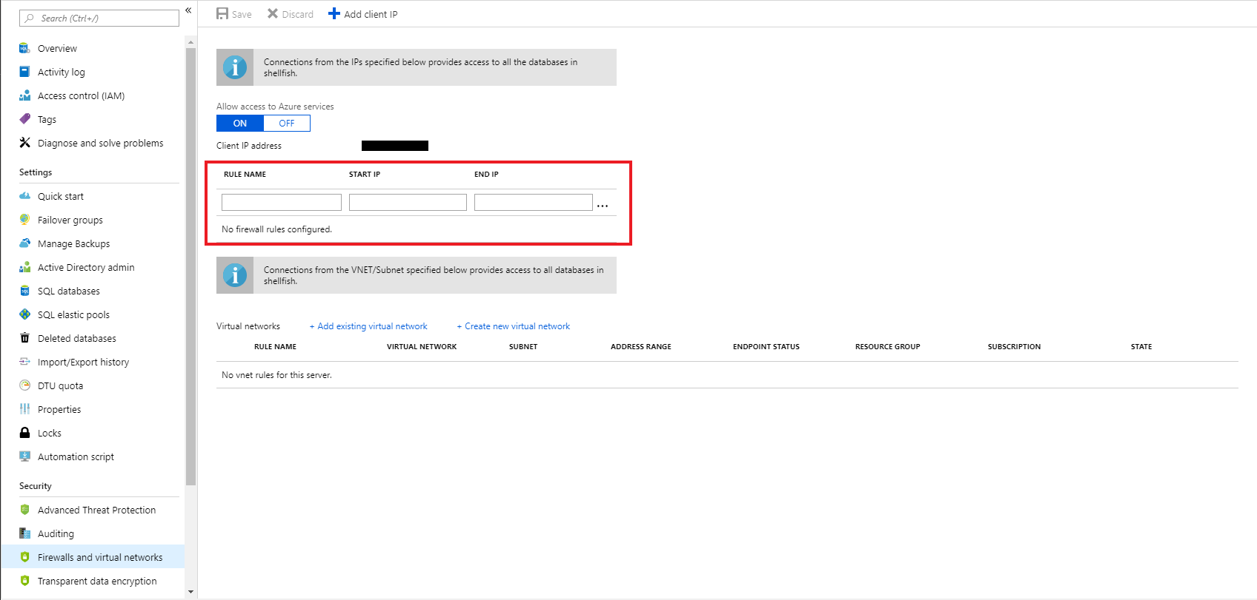
Firewall configuration on the portal
By default, Azure blocks all external connections to port 1433
Configure with the following steps:
Azure Synapse Analytics Resource: Server name > Firewalls and virtual networks
Notes:
Objective: The first line of defense when controlling access to Microsoft Azure SQL Data Warehouse involves IP address and port filtering on the Azure SQL Server instance level, implemented as firewall rules defined in its master database.
Talking Points:
The firewall restricts incoming traffic to TCP port 1433 only. In addition, by default, all external (from the Azure point of view) connections are blocked, so you need to explicitly enable them by specifying the public IP address (or IP address range) assigned to your Internet entry point.
Azure Portal

Slide 55
Managed VNet
Overview
Creating a workspace with a Managed workspace VNet associated with it ensures that user’s workspace is network isolated from other workspaces. The VNet associated with your workspace is managed by Azure Synapse. This VNet is called a Managed workspace VNet.
Benefits
With a Managed workspace customers can offload the burden of managing the VNet to Azure Synapse.
Customers don’t have to configure inbound NSG rules on their own VNets to allow Azure Synapse management traffic to enter their VNet.
Customers don't need to create a subnet for your Spark clusters based on peak load.
Managed workspace VNet along with Managed private endpoints protects against data exfiltration.

Slide 56
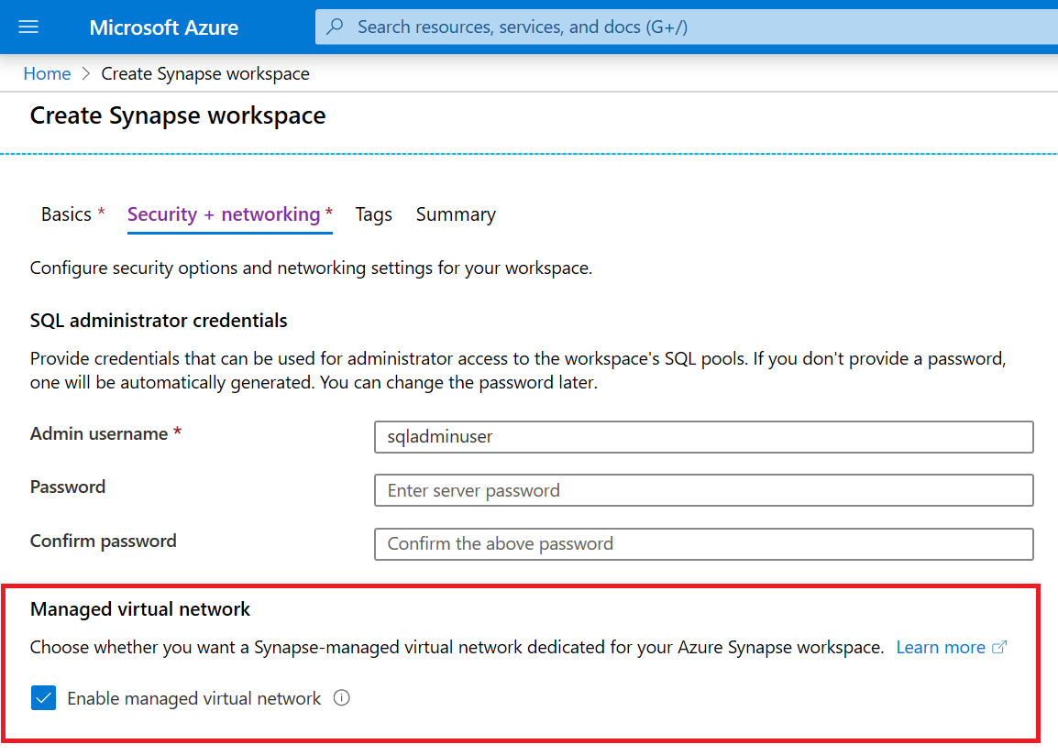
Managed VNet
Overview
During Azure Synapse workspace creation, user can choose to associate it to a managed VNet. User cannot change this workspace configuration after the workspace is created.
User cannot reconfigure a workspace that does not have a Managed workspace VNet associated with it and associate a VNet to it.
Private links are supported only in Synapse workspaces that have a managed VNet associated to it.

Slide 57
Private Endpoints
Overview
Managed private endpoints are private endpoints created in the Managed workspace VNet establishing a private link to Azure resources. Managed private endpoints are only supported in Azure Synapse workspaces with a Managed workspace VNet.
Benefits
Private link enables customers to access Azure services and Azure hosted customer/partner services from their Azure VNet securely.
With use of private link, traffic between customer’s VNet and workspace traverses entirely over the Microsoft backbone network.
Private link protects against data exfiltration risks.
Private endpoint uses a private IP address from customer’s VNet to effectively bring the service into their VNet.
Private endpoints are mapped to a specific resource in Azure and not the entire service.

Slide 58


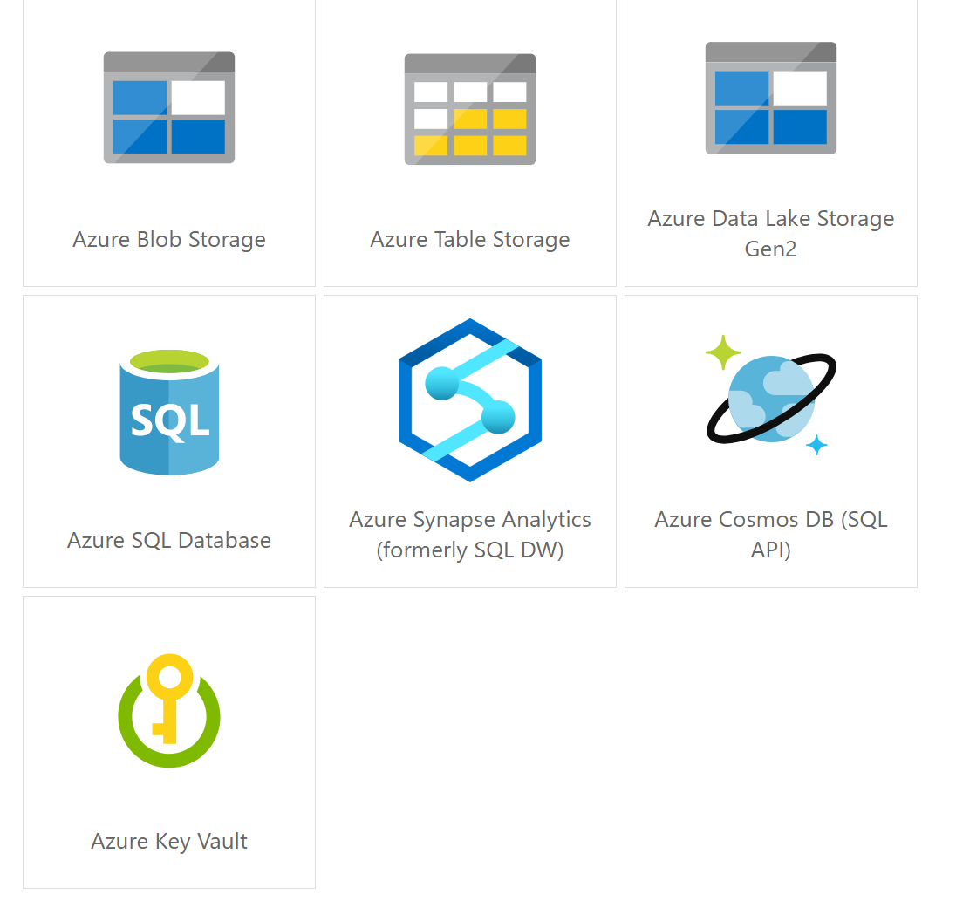
Managed VNets in the Synapse Workspace
The two Managed private endpoints to SQL pool and serverless SQL automatically created in Synapse when the Managed workspace VNet is deployed.
Synapse Workspace
Managed VNet
Managed
private endpoint to serverless SQL
Workspace
Serverless SQL
Synapse Studio
Managed
private endpoint to SQL Pool
Workspace
SQL Pool
Managed private endpoint
Spark Clusters
Other data sources
that support Private Link
(e.g. Cosmos DB,
Azure Storage, ADLS etc.)
The private endpoint establishes a private link between your
Azure Synapse Analytics workspace and your data sources where traffic between your VNet and workspace traverses entirely over the Microsoft backbone network.
Internet

Slide 59

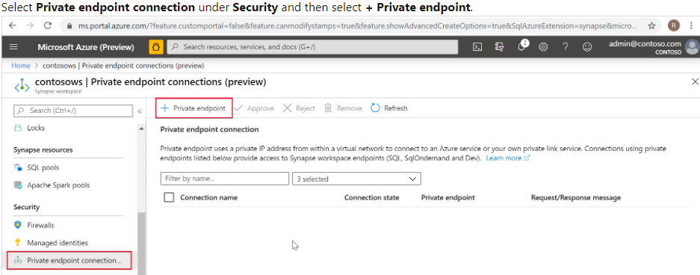
Connecting to Synapse from On-Premises
On-Premises VNet
Synapse Workspace
Managed VNet
Dedicated SQL tenant
*.sql.azuresynapse.net
Managed private endpoint to serverless SQL
Serverless SQL tenant
*-ondemand.sql.azuresynapse.net
Managed PE to SQL Pool
Dev tenant
*.dev.sql.azuresynapse.net
Azure VNET
Subnet
VPN Gateway
Private endpoint
Private endpoint
Private endpoint
site-to-site
point-to-site
Notes:
Check this article to learn how to create private endpoins to your Azure Synapse workspace: https://docs.microsoft.com/en-us/azure/synapse-analytics/security/how-to-connect-to-workspace-with-private-links

Slide 60


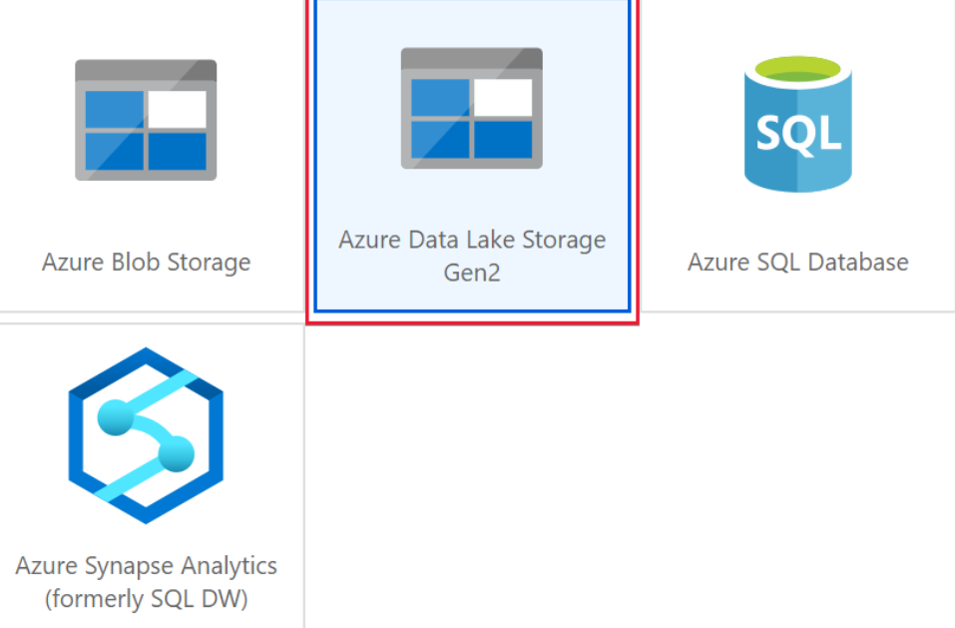
Self-hosted Integration Runtime in Synapse Workspace
Azure Data Factory
*.frontend.clouddatahub.net
Azure ServiceBus
*.servicebus.windows.net
Optional, required when using the staged copy feature
Self-hosted Integration Runtime
(on-premise)
Azure Storage
*.core.windows.net
Optional, required when the Self-hosted integration runtime has auto-update enabled
443
download.microsoft.com
Synapse Workspace
Azure
Integration Runtime
Self-Hosted
Integration Runtime
Managed VNET
Workspace
SQL on-demand endpoint
Synapse Studio
Private endpoint to SQL on-demand
Private endpoint to SQL Pool
Workspace
SQL Pool
endpoint
Private endpoint
Spark Clusters
Supports up to 4 nodes for high availability and scalability
Other data sources
that support Private Link
(e.g. Cosmos DB, Azure Storage etc.)
Internet

Slide 61
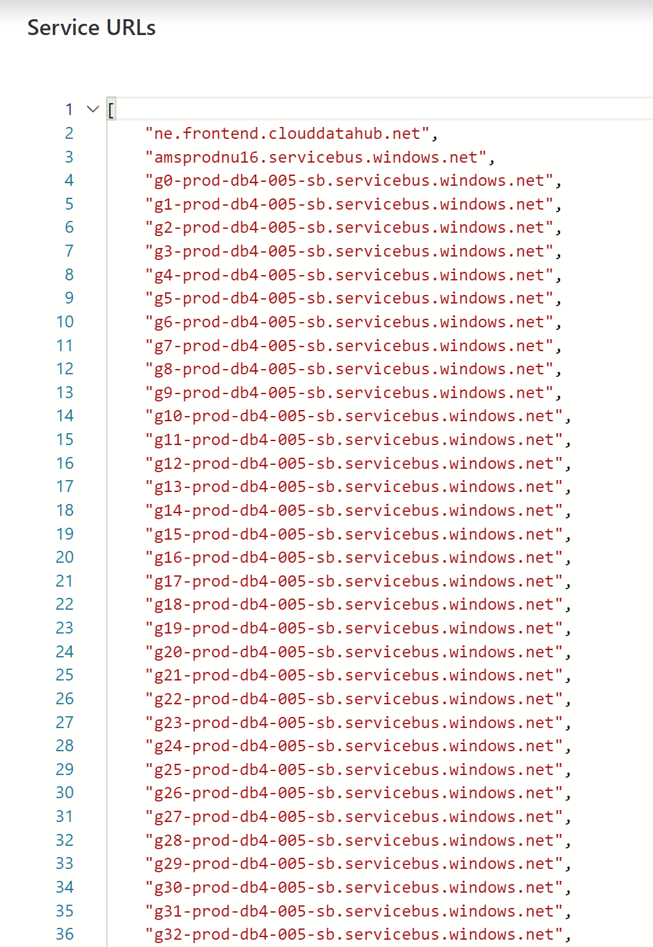
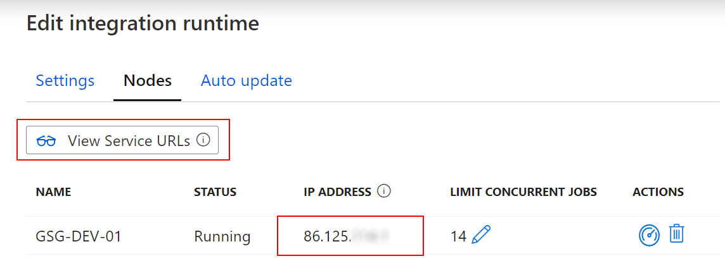
Self-hosted Integration Runtime in Synapse Workspace
Whitelisting of specific public Azure endpoints
Whitelisting of IR-specific IP addresses

Slide 62
Data Security in Synapse

Slide 63

Azure Active Directory authentication
Overview
Manage user identities in one location.
Enable access to Azure Synapse Analytics and other Microsoft services with Azure Active Directory user identities and groups.
Benefits
Enables management of database permissions by using external Azure Active Directory groups
Allows password rotation in a single place
Alternative to SQL Server authentication
Eliminates the need to store passwords
Secure ADLS Gen 2 using a combination of RBAC and ACLs
Azure Synapse Analytics
Notes:
Objective: Azure Active Directory authentication is a mechanism for connecting to Microsoft Azure SQL Database or Data Warehouse by using identities in Azure Active Directory. Azure SQL Database is used to refer to both SQL Database and SQL Data Warehouse in the para below.
Talking Points:
With Azure Active Directory authentication, you can centrally manage the identities of database users and other Microsoft services in a single location. Central identity management provides a single place to manage Azure SQL Database users and simplifies permission management. Benefits include:
An alternative to SQL Server authentication.
Help in stopping the proliferation of user identities across database servers.
The ability to perform password rotation in a single place.
Management of database permissions by using external Azure Active Directory groups.
Elimination of the need to store passwords: it enables integrated Windows authentication and other forms of authentication supported by Azure Active Directory.
Azure Active Directory authentication uses contained database users to authenticate identities at the database level.
Azure Active Directory members created in the managed domain or with a federated domain can be provisioned in Azure SQL Database.
Two-factor authentication or other forms of interactive authentication are supported.
Limitations:
Microsoft accounts (for example outlook.com, hotmail.com, live.com) or other guest accounts (for example gmail.com, yahoo.com) are not supported.
Only one Azure Active Directory administrator (a user or group) can be configured for an Azure SQL Database at any time.
Only an Azure Active Directory administrator can initially connect to the Azure SQL Database by using an Azure Active Directory account. The Azure Active Directory administrator can configure subsequent Azure Active Directory database users.
Some tools, like business intelligence (BI) and Microsoft Office Excel, are not supported.
Azure Active Directory authentication is supported by .NET Framework Data Provider for SQL Server (at least version in .NET Framework version 4.6).
Therefore SQL Server Management Studio (available with SQL Server 2016) and data-tier applications (DAC and .bacpac) can connect.
ODBC version 13.1 supports Azure Active Directory authentication
The sqlcmd.exe supports Azure Active Directory authentication beginning with version 13.1
PolyBase cannot authenticate by using Azure AD authentication.
Microsoft JDBC Driver 6.0 for SQL Server supports Azure AD authentication.
https://docs.microsoft.com/en-us/azure/sql-database/sql-database-aad-authentication
MFA related:
https://docs.microsoft.com/en-us/azure/sql-database/sql-database-ssms-mfa-authentication?toc=/azure/sql-data-warehouse/toc.json
https://docs.microsoft.com/en-us/sql/ssdt/azure-active-directory?view=azuresqldb-current
https://docs.microsoft.com/en-us/sql/tools/sqlcmd-utility?view=sql-server-2017
https://docs.microsoft.com/en-us/sql/tools/bcp-utility?view=sql-server-2017

Slide 64

Row-level security (RLS)
Overview
Fine grained access control of specific rows in a database table.
Help prevent unauthorized access when multiple users share the same tables.
Eliminates need to implement connection filtering in multi-tenant applications.
Administer via SQL Server Management Studio or SQL Server Data Tools.
Easily locate enforcement logic inside the database and schema bound to the table.
Customer 1
Customer 2
Customer 3
SQL Data Warehouse
Notes:
Objective: Row-Level Security (RLS) simplifies the design and coding of security in your application.
Talking Points:
RLS enables you to implement restrictions on data row access. For example, ensuring that workers can access only those data rows that are pertinent to their department, or restricting a customer's data access to only the data relevant to their company.
The access restriction logic is located in the database tier rather than away from the data in another application tier. The database system applies the access restrictions every time that data access is attempted from any tier. This makes your security system more reliable and robust by reducing the surface area of your security system.
Implement RLS by using the CREATE SECURITY POLICY Transact-SQL statement, and predicates created as inline table valued functions.
Source: https://docs.microsoft.com/en-us/sql/relational-databases/security/row-level-security?toc=%2Fazure%2Fsql-data-warehouse%2Ftoc.json&view=sql-server-2017

Slide 65
Row-level security
Creating policies
Filter predicates silently filter the rows available to read operations (SELECT, UPDATE, and DELETE).
The following examples demonstrate the use of the CREATE SECURITY POLICY syntax
-- The following syntax creates a security policy with a filter predicate for the Customer table
CREATE SECURITY POLICY [FederatedSecurityPolicy]
ADD FILTER PREDICATE [rls].[fn_securitypredicate]([CustomerId])
ON [dbo].[Customer];
-- Create a new schema and predicate function, which will use the application user ID stored in CONTEXT_INFO to filter rows.
CREATE FUNCTION rls.fn_securitypredicate (@AppUserId int)
RETURNS TABLE
WITH SCHEMABINDING
AS
RETURN (
SELECT 1 AS fn_securitypredicate_result
WHERE
DATABASE_PRINCIPAL_ID() = DATABASE_PRINCIPAL_ID('dbo') -- application context
AND CONTEXT_INFO() = CONVERT(VARBINARY(128), @AppUserId));
GO
Notes:
Objective: Row-level filtering of data selected from a table is enacted through a security predicate filter defined as an inline table valued function. The function is then invoked and enforced by a security policy. The policy can restrict the rows that may be viewed (a filter predicate), but does not restrict the rows that can be inserted or updated from a table (a blocking predicate). There is no indication to the application that rows have been filtered from the result set; if all rows are filtered, then a null set will be returned.
** Azure SQL Data Warehouse doesn’t yet support block predicates.
Talking Points:
Filter predicates are applied while reading data from the base table, and it affects all get operations: SELECT, DELETE (i.e. user cannot delete rows that are filtered), and UPDATE (i.e. user cannot update rows that are filtered, although it is possible to update rows in such way that they will be subsequently filtered). Blocking predicates are not available in this version of RLS, but equivalent functionality (i.e. user cannot INSERT or UPDATE rows such that they will subsequently be filtered) can be implemented using check constraints or triggers.
Filter predicates and security policies have the following behavior:
Define a security policy that filters the rows of a table. The application is unaware that any rows have been filtered for SELECT, UPDATE, and DELETE operations, including situations where all the rows have been filtered out. The application can INSERT any rows, regardless of whether or not they will be filtered during any other operation. Define a predicate function that joins with another table and/or invokes a function. The join/function is accessible from the query and works as expected without any additional permission checks.
Issue a query against a table that has a security predicate defined but disabled. Any rows that would have been filtered or restricted are not affected.
The dbo user, a member of the db_owner role, or the table owner queries against a table that has a security policy defined and enabled. Rows are filtered/restricted as defined by the security policy.
Attempts to alter the schema of a table bound by a security policy will result in an error. However, columns not referenced by the filter predicate can be altered.
Attempts to add a predicate on a table that already has one defined (regardless of whether it is enabled or disabled) results in an error.
Attempts to modify a function used as a predicate on a table within a security policy results in an error.
Defining multiple active security policies that contain non-overlapping predicates, succeeds.
Source: https://docs.microsoft.com/en-us/sql/relational-databases/security/row-level-security?view=sql-server-2017

Slide 66

Column-level security
Overview
Control access of specific columns in a database table based on customer’s group membership or execution context.
Simplifies the design and implementation of security by putting restriction logic in database tier as opposed to application tier.
Administer via GRANT T-SQL statement.
Both Azure Active Directory (AAD) and SQL authentication are supported.
Notes:
Objective: Column-Level Security (CLS) simplifies the design and coding of security in your application.
Use Cases
Some examples of how CLS is being used today:
A financial services firm allows only account managers to have access to customer social security numbers (SSN), phone numbers, and other personally identifiable information (PII).
A health care provider allows only doctors and nurses to have access to sensitive medical records while not allowing members of the billing department to view this data.
Source: https://docs.microsoft.com/en-us/azure/sql-data-warehouse/column-level-security

Slide 67
Dynamic Data Masking
Overview
Prevent abuse of sensitive data by hiding it from users
Easy configuration in new Azure Portal
Policy-driven at table and column level, for a defined set of users
Data masking applied in real-time to query results based on policy
Multiple masking functions available, such as full or partial, for various sensitive data categories (credit card numbers, SSN, etc.)
Table.CreditCardNo
4465-6571-7868-5796
4468-7746-3848-1978
4484-5434-6858-6550
SQL Database
Real-time data masking, partial masking
CreditCardNo
XXXX-XXXX-XXXX-5796
XXXX-XXXX-XXXX-1978
Notes:
Objective: Dynamic data masking limits sensitive data exposure by masking it to non-privileged users. Dynamic data masking helps prevent unauthorized access to sensitive data by enabling customers to designate how much of the sensitive data to reveal with minimal impact on the application layer. It’s a policy-based security feature that hides the sensitive data in the result set of a query over designated database fields, while the data in the database is not changed. Dynamic data masking is easy to use with existing applications, since masking rules are applied in the query results, and there is no need to modify existing queries.
Talking Points:
For example, a call center support person may identify callers by several digits of their social security number or credit card number, but those data items should not be fully exposed to the support person. A developer can define a masking rule to be applied to each query result that masks all but the last four digits of any social security number or credit card number in the result set. For another example, by using the appropriate data mask to protect personally identifiable information (PII) data, a developer can query production environments for troubleshooting purposes without violating compliance regulations.
Dynamic data masking limits the exposure of sensitive data and prevents accidental viewing by engineers that access directly databases for troubleshooting purposes or non-privileged application users. Dynamic data masking doesn’t aim to prevent privileged database users from connecting directly to the database and running exhaustive queries that expose pieces of the sensitive data. Dynamic data masking is complimentary to other SQL Server security features (auditing, encryption, row level security…) and it is highly recommended to enable them in addition in order to protect better the sensitive data in the database.
Since data is masked just before being returned to the user, changing the data type to an unmasked type will return unmasked data.
Dynamic data masking is available in SQL Server 2016 .However, to enable dynamic data masking, you must use trace flags 209 and 219. For SQL Database, see https://docs.microsoft.com/en-us/azure/sql-database/sql-database-dynamic-data-masking-get-started.
Source: https://msdn.microsoft.com/en-us/library/mt130841(v=sql.130).aspx

Slide 68

Column Level Encryption
Overview
It helps to implement fine-grained protection of sensitive data within a table in dedicated SQL pool.
The data in CLE enforced columns is encrypted on disk. User need to use DECRYPTBYKEY function to decrypt it.
5 step process to set up CLE
Create master key
Create certificate
Configure symmetric key for encryption
Encrypt the column data
Close symmetric key
Notes:
Encrypt a Column of Data - SQL Server & Azure Synapse Analytics & Azure SQL Database & SQL Managed Instance | Microsoft Docs

Slide 69
Types of data encryption
Data Encryption | Encryption Technology | Customer Value
In transit | Transport Layer Security (TLS) from the client to the server TLS 1.2 | Protects data between client and server against snooping and man-in-the-middle attacks
At rest | Transparent Data Encryption (TDE) for Azure Synapse Analytics | Protects data on the disk User or Service Managed key management is handled by Azure, which makes it easier to obtain compliance
In use
In transit
At rest
Column encryption
Customer data
Database files, backups, Tx log, TempDB
Notes:
Objective: Azure SQL DW includes several additional security measures for data. This slide provides an overview of SQL encryption in transit, at rest, and end-to-end.
Talking Points:
Key takeaway: Encrypted sensitive data and its corresponding keys are never seen in plain text in SQL Server
The customer will need to verify in the Azure Portal that the database is encrypted via PowerShell/T-SQL
Encryption-In-Transit technologies:
TLS from Client to Server
TLS = Transport Layer Security
Encryption at rest technologies:
TDE = Transparent Data Encryption
** SQL Data Warehouse doesn’t support Always-Encryption yet.

Slide 70
Transparent data encryption (TDE)
Overview
All customer data encrypted at rest
TDE performs real-time I/O encryption and decryption of the data and log files.
Service OR User managed keys.
Application changes kept to a minimum.
Transparent encryption/decryption of data in a TDE-enabled client driver.
Compliant with many laws, regulations, and guidelines established across various industries.
USE master;
GO
CREATE MASTER KEY ENCRYPTION BY PASSWORD = '<UseStrongPasswordHere>';
go
CREATE CERTIFICATE MyServerCert WITH SUBJECT = 'My DEK Certificate';
go
USE MyDatabase;
GO
CREATE DATABASE ENCRYPTION KEY
WITH ALGORITHM = AES_128
ENCRYPTION BY SERVER CERTIFICATE MyServerCert;
GO
ALTER DATABASE MyDatabase
SET ENCRYPTION ON;
GO
Notes:
Talking Points:
Fully managed by Azure
Support for user-managed TDE using Azure Key Vault
Simple Interface
Single SQL Statement/API call to enable/disable
Predictable Encryption Performance
Uses Azure SQL Database’s editions to ensure predictable performance
AES-NI Hardware Acceleration
Intel’s AES-NI support in TDE means better performance and better value

Slide 71
Transparent data encryption (TDE)
Key Vault
Benefits with User Managed Keys
Assume more control over who has access to your data and when.
Highly available and scalable cloud-based key store.
Central key management that allows separation of key management and data.
Configurable via Azure Portal, PowerShell, and REST API.
Azure Active Directory
2
Portal
1
Azure SQL Service
PowerShell
Rest API
Azure Key Vault
3
1
The Key Vault admin grants vault access to the SQL Database server using its unique Azure Active Directory (AD) identity
2
The server uses its Azure AD identity to authenticate with Azure AD for access to your Key Vault
3
The server sends get, wrap key, and unwrap key request to the asymmetric key in key Vault for database encryption key protection.
Notes:
Talking Points:
Fully managed by Azure
Support for user-managed TDE using Azure Key Vault
Simple Interface
Single SQL Statement/API call to enable/disable
Predictable Encryption Performance
Uses Azure SQL Database’s editions to ensure predictable performance
AES-NI Hardware Acceleration
Intel’s AES-NI support in TDE means better performance and better value

Slide 72
Thank You slide
Thank you

Slide 73
Monitor & Manage

Slide 74
Agenda
1 Monitoring
Monitor resources within Synapse Studio and the Azure Portal.
2 Manage
Manage resources for optimal utilization and performance.

Slide 75


Discussion…
How has the role of a DBA changed in the era of managed Data- Warehouses-as-a-Service?

Slide 76

Monitor Hub
Overview
This feature provides single pane of glass to monitor orchestration, activities for Apache Spark Application and SQL requests.
Benefits
Offers additional filters to monitor specific activities or orchestration

Slide 77


Monitor Hub – SQL requests
Overview
Monitor SQL requests for the progress and status of activities
Benefits
Apply filter for pool to get SQL requests per compute pool
Validate query text
Additional available filters include
Start time
End time
Request ID
Session ID
Submitter
Workload group

Slide 78


Monitor Hub – Analytics pools

Slide 79

Monitor SQL Pools
Overview
Monitor SQL Pool in Azure Portal for overall usage and query activities.
Benefits
Access SQL Audit Logs for my SQL computes
Monitor status and progress of all/specific activities
Dashboard view to monitor performance
Get to know scale of SQL compute resource

Slide 80
Manage

Slide 81
Workload Management
Pillars of Workload Management
Overview
It manages resources, ensures highly efficient resource utilization, and maximizes return on investment (ROI).
Synapse is moving away from Resource Class and Concurrency Slots to Workload Management.
The three pillars of workload management are
Workload Classification – To assign a request to a workload group and setting importance levels.
Workload Importance – To influence the order in which a request gets access to resources.
Workload Isolation – To reserve resources for a workload group.
Classification
Importance
Isolation

Slide 82
Workload classification
Overview
Map queries to allocations of resources via pre-determined rules.
Use with workload importance to effectively share resources across different workload types.
If a query request is not matched to a classifier, it is assigned to the default workload group.
Benefits
Map queries to both Resource Management and Workload Isolation concepts.
Monitoring DMVs
sys.workload_management_workload_classifiers sys.workload_management_workload_classifier_details
Query DMVs to view details about all active workload classifiers.
CREATE WORKLOAD CLASSIFIER classifier_name
WITH
(
WORKLOAD_GROUP = 'name’
, MEMBERNAME = ‘security_account'
[ [ , ] IMPORTANCE = {LOW|BELOW_NORMAL|NORMAL|ABOVE_NORMAL|HIGH} ] )
[ [ , ] WLM_LABEL = 'label' ]
[ [ , ] WLM_CONTEXT = 'name' ]
[ [ , ] START_TIME = 'start_time' ]
[ [ , ] END_TIME = 'end_time' ]
)[ ; ]
WORKLOAD_GROUP: maps to an existing resource class
IMPORTANCE: specifies relative importance of request
MEMBERNAME: database user, role, AAD login or AAD group

Slide 83


Workload importance
Overview
Queries past the concurrency limit enter a FiFo queue
By default, queries are released from the queue on a first-in, first-out basis as resources become available
Workload importance allows higher priority queries to receive resources immediately regardless of queue
Example Video
State analysts have normal importance.
National analyst is assigned high importance.
State analyst queries execute in order of arrival
When the national analyst’s query arrives, it jumps to the top of the queue
Azure Synapse
Analytics
CREATE WORKLOAD CLASSIFIER National_Analyst
WITH
(
WORKLOAD_GROUP = ‘analyst’
,IMPORTANCE = HIGH
,MEMBERNAME = ‘National_Analyst_Login’)
Notes:
Video example:
National Analyst is given a higher workload importance value

Slide 84
Workload Isolation
Overview
Allocate fixed resources to workload group.
Assign maximum and minimum usage for varying resources under load. These adjustments can be done live without having to take SQL Analytics offline.
Benefits
Reserve resources for a group of requests
Limit the amount of resources a group of requests can consume
Shared resources accessed based on importance level
Set Query timeout value. Get DBAs out of the business of killing runaway queries
Monitoring DMVs
sys.workload_management_workload_groups
Query to view configured workload group.
CREATE WORKLOAD GROUP group_name
WITH
(
MIN_PERCENTAGE_RESOURCE = value
, CAP_PERCENTAGE_RESOURCE = value
, REQUEST_MIN_RESOURCE_GRANT_PERCENT = value
[ [ , ] REQUEST_MAX_RESOURCE_GRANT_PERCENT = value ]
[ [ , ] IMPORTANCE = {LOW | BELOW_NORMAL | NORMAL | ABOVE_NORMAL | HIGH} ]
[ [ , ] QUERY_EXECUTION_TIMEOUT_SEC = value ]
)[ ; ]
Notes:
https://docs.microsoft.com/en-us/azure/sql-data-warehouse/sql-data-warehouse-workload-isolation

Slide 85
Discussion…
What are some of the advantages and disadvantages of workload isolation versus SQL Pool scaling?
Notes:
Scale can increase overall capacity, but empties the cache which slows performance.
Workload isolation can be more responsive to quick changes in workload.

Slide 86



Continuous integration and delivery (CI/CD)
Overview
Database project support in SQL Server Data Tools (SSDT) allows teams of developers to collaborate over a version-controlled Azure Synapse Analytics, and track, deploy and test schema changes.
Benefits
Database project support includes first-class integration with Azure DevOps. This adds support for:
Azure Pipelines to run CI/CD workflows for any platform (Linux, macOS, and Windows)
Azure Repos to store project files in source control
Azure Test Plans to run automated check-in tests to verify schema updates and modifications
Growing ecosystem of third-party integrations that can be used to complement existing workflows (Timetracker, Microsoft Teams, Slack, Jenkins, etc.)
Notes:
Continuous integration and delivery for Synapse workspace - Azure Synapse Analytics | Microsoft Docs

Slide 87

Azure Advisor recommendations
Suboptimal Table Distribution
Reduce data movement by replicating tables
Data Skew
Choose new hash-distribution key
Slowest distribution limits performance
Cache Misses
Provision additional capacity
Tempdb Contention
Scale or update user resource class
Suboptimal Plan Selection
Create or update table statistics

Slide 88

Maintenance windows
Overview
Choose a time window for your upgrades.
Select a primary and secondary window within a seven-day period.
Windows can be from 3 to 8 hours.
24-hour advance notification for maintenance events.
Benefits
Ensure upgrades happen on your schedule.
Predictable planning for long-running jobs.
Stay informed of start and end of maintenance.

Slide 89
Manage Summary
Resource contention can be mitigated by applying Workload Management in Azure Synapse Analytics.
Workload Classification: Assign a request to a workload group and set importance levels.
Workload Importance: Influence the order in which a request gets access to resources.
Workload Isolation: Reserve resources for a workload group.
Use Azure Advisor recommendations to identify suboptimal table distribution, data skew, cache misses, tempdb contention, and suboptimal plan selection.
Avoid disruptive system downtime due to system upgrades by configuring maintenance windows and notifications in Azure Synapse Analytics.
Notes:
Exploratory queries that were not time sensitive can saturate the available resources and delay the execution of higher priority queries supporting critical reports, how can one mitigate this?
Separate marketing workloads from say the finance workloads using workload management.
Configure Workload Management in Azure Synapse Analytics which serves to prevent this situation.
It manages resources, ensures highly efficient resource utilization, and maximizes return on investment (ROI).
The three pillars of Workload Management are:
Workload Classification – To assign a request to a workload group and set importance levels.
Workload Importance – To influence the order in which a request gets access to resources.
Workload Isolation – To reserve resources for a workload group.
If workload management does not suffice, note that online scaling (which allows you to increase the cluster size without incurring downtime) and multi-cluster (which allows you to have several different clusters supporting a single data warehouse) are features that are coming soon.
How can you identify issues such as suboptimal table distribution, data skew, cache misses, tempdb contention and suboptimal plan selection?
Leverage the Azure Advisor recommendations.
There is a balance between the data warehouse software staying up to date and when a customer can afford downtime that might result. How can they establish their preferences, so they are never caught off guard with an upgrade?
Leverage maintenance windows, a feature of Azure Synapse Analytics. Within this they can:
Choose a time window for upgrades.
Select a primary and secondary window within a seven-day period, where windows can be from 3 to 8 hours.
Receive 24-hour advance notification for maintenance events.

Slide 90

Mentimeter Poll
Scan QR Code
or Go to www.menti.com and use code
66 85 335

Slide 91
Thank you

Slide 92
Break
Please take this time for a short 15 minute break
Relax and come back refreshed for our next activity
If at anytime you require assistance please send a message to the “Need help – ask here” channel in the Microsoft Teams site for this event

Slide 93








POC Challenges 3 & 4: group-based lab exercises
GUIDE:
PoC Challenge
https://github.com/solliancenet/azure-synapse-analytics-workshop-300-2-day
Step 1: Go to your table group channel
Step 2: You will use your cloud lab login for Azure
Step 3: Login to Azure. Engage your table group via a Microsoft Teams “meet now” call to collaborate with each other (meet now button in upper right corner of application)

Slide 94

Day 2 Wrap Up
Thank you for your participation in the Day 2 Technical Boot Camp
What was covered today:
Implement a process that trains a machine learning model, registers it for use and utilizes the model for scoring using the Predict statement. ​
Apply security concepts including row level security, object level security, column level security, sensitive data discovery and classification and access controls to a customer scenario.
Address scenarios the involve the design of how to monitor and manage a solution implemented with Azure Synapse Analytics.
If at anytime you require assistance, please send a message to the “Need help – ask here” channel in the Microsoft Teams site for this event

Slide 95
A few takeaways
Never trust already existing data or structure
Make sure you run your data processes “pedal to the metal”
Always work on small subsets first
Assume all files are “bad” – “good” is just a nice surprise
Fail fast, change optics even faster
Don’t be shy of moving out of the SQL world
Think outside of the box
Explore first, then understand, then “solve”

Slide 96


We’d love to hear from you!
Day 1 | Day 2
Scan the QR code below using your smartphone or access the link https://aka.ms/BC_EMEA_Day1 You’ll also receive a link to this survey by email. You only need to complete it once. Answer the survey questions to provide your feedback on Day 1 of Boot Camp. Be honest. Every bit of feedback helps us improve. | Scan the QR code below using your smartphone or access the link https://aka.ms/BC_EMEA_Day2 You’ll also receive a link to this survey by email. You only need to complete it once. Answer the survey questions to provide your feedback on Day 2 of Boot Camp. Be honest. Every bit of feedback helps us improve.

